Slide 1



Fraud
Detection
Presented by: Daksh Rakholiya

Slide 2


Objective
•Online payment is the most popular transaction method in the world today. However, with an increase in online payments also comes a rise in payment fraud.
•To identify online payment fraud with machine learning, we need to train a machine learning model for classifying fraudulent and non-fraudulent payments. For this, we need a dataset containing information about online payment fraud, so that we can understand what type of transactions lead to fraud.

Slide 3
INTRODUCTION
•For a long time, online transaction fraudsters and detectors have played a complex role. Transaction fraud is more widespread than it has ever been, especially in the Internet era, and it causes enormous financial losses.
•The Nilsson research delved into the global landscape of online transaction fraud in considerable depth. Fraudulent online transactions cost the economy $21 billion in 2015, $24 billion in 2016, and more than $27 billion in 2017. The global rate of online transaction fraud is expected to rise year after year, reaching $31.67 billion in 2020.
•Banks and financial service providers may be forced to implement an automated online fraud detection system to detect and monitor online transactions as a result. By isolating aberrant activity patterns from a huge number of transactional records, fraud detection systems are able to detect and monitor incoming transactions.
•Machine learning has been shown to be quite good at detecting these patterns. A vast quantity of transaction records, on the other hand, may be used to train a high-performing fraud classifier. Despite the fact that supervised learning has been shown to be quite successful at detecting fraudulent transactions, transactional fraud analysis technology will continue to advance. Small adjustments might help a corporation save a lot of money. There are certain problems with the unique approach of unsupervised and regulated online fraud detection.

Slide 4
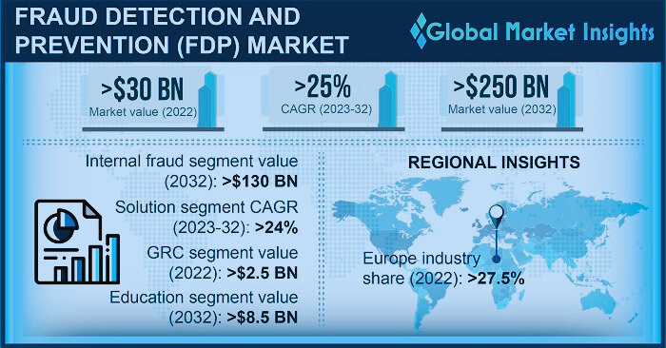

Slide 5
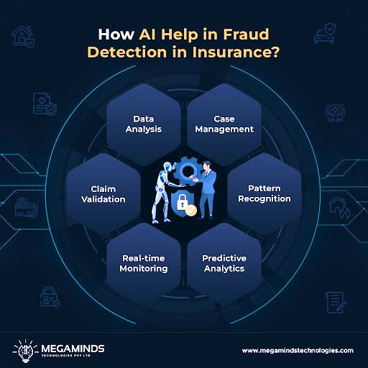



VALUES OF THE STUDY

Slide 6
Model Training
Feature Etraction
04
05
Train Machine Learning model
e.g - Logistic Regression, Random
forest and other.
Identify and select important
feature like transaction amount
and frequency
WORK FLOW
Exploratory Data Analysis
Model Validation
06
03
Analyzing and visualizing data patterns to understand its characteristics.
Test model accuracy with a
separate dataset.
Data Preprocessing
07
Deployment
02
Clean and organize data,
Handle missing values and
normalize.
Integrate the model into live system
to monitor live transactions.
Start with Data Collection
Alert Generation
01
08
Gather historical transaction data
(legitimate and fraudulent)
Generate alert for Suspicious
transactions.

Slide 7



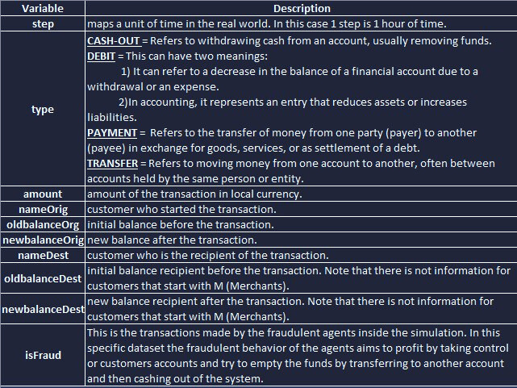
01
Start with Data Collection

Slide 8
2,3
Exploratory Data Analysis
Exploratory Data Analysis (EDA) helped us understand the data structure, find patterns, identify trends, and gain valuable insights from the dataset.
From EDA we analyze, the distribution of each features, checking the correlation between the features .
Using visuals helped us see the data clearly, understand the online transation data relationship with each other, and pinpoint factors that plays vital role in predictions of trasnartion is fraudlent or not.
1. Data Exploration:
Dataset Overview:
Contains 11,142 rows and 10 columns.
Key features include transaction type, amount, and account balances before and after transactions.
Missing Values & Duplicates:
Checked for missing values and duplicates:- both are none were significant enough to impact analysis.

Slide 9
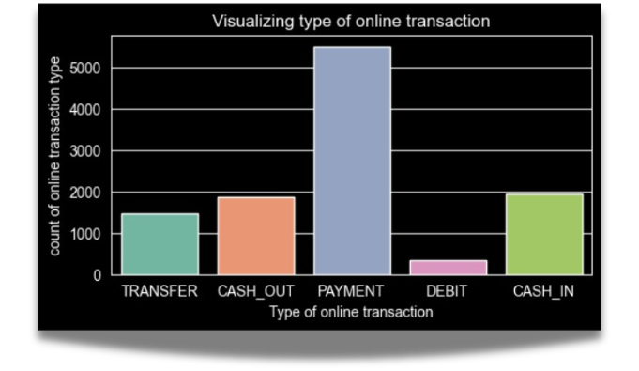
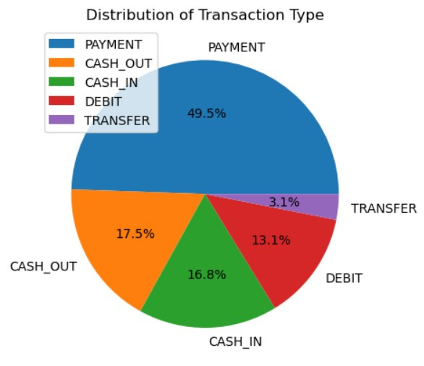
2. Univariate Analysis:
Visualized the distribution of transaction types,
highlighting that cash_out and payment are the most common.
Identified that the majority of transactions are not fraudulent.
We can see that Distribution of Transartion Type in pie chart of.
The percentages for each type will be shown on the slices, making it easy to see which transaction types are most and least common.

Slide 10
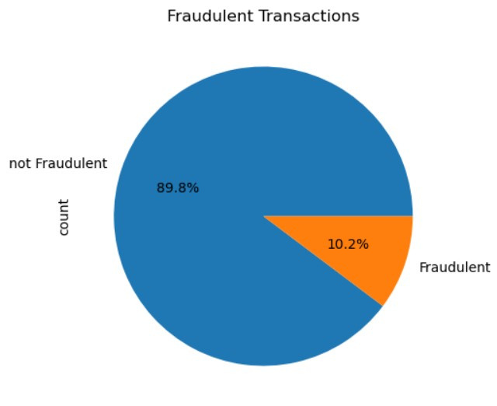
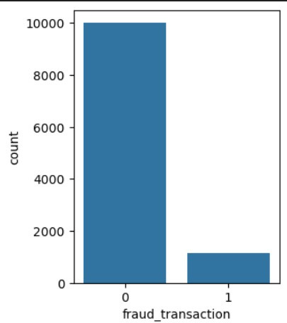
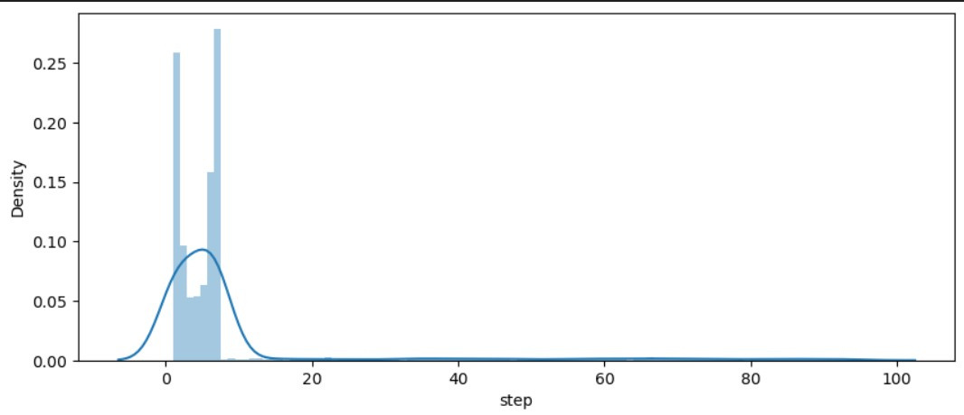
Visualization of Fraudulent Transactions
Here plot pie chart of Fraudulent Transactions Column
we can see that only 10.2% is fraudulent and rest of the
transaction is not fraudulent. Its shows that most of the
online transactions customers does is not fraudulent.
Also Data of Transaction is not balance.
Visualization of Step
Distributed of step column and we
identify most of the transactions
done in less than 20 step.

Slide 11
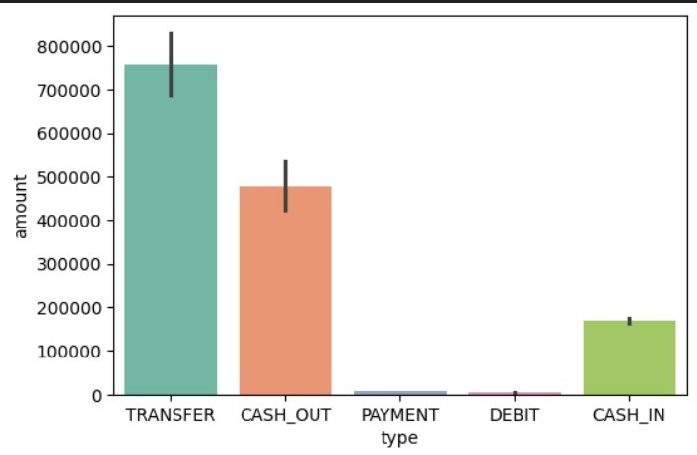
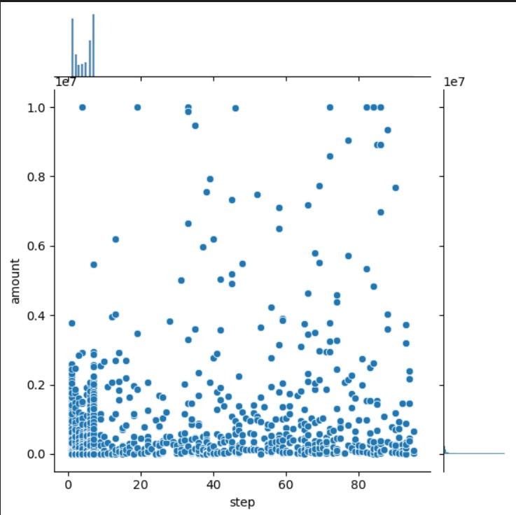
3. Bivariate Analysis:
Visualization of Transaction Amounts by Type
Analyzed the relationship between transaction amounts and types,
revealing that transfer transactions involve the highest amounts.
Observed that cash_out and transfer types correlate with fraudulent
transactions.
Visualization of Amounts by Steps
In this visualization, we use a joint plot to explore the relationship
between the transaction steps and the corresponding amounts.
This analysis helps us understand how the transaction amount varies across different steps, providing insights into customer behavior and transaction flow.

Slide 12
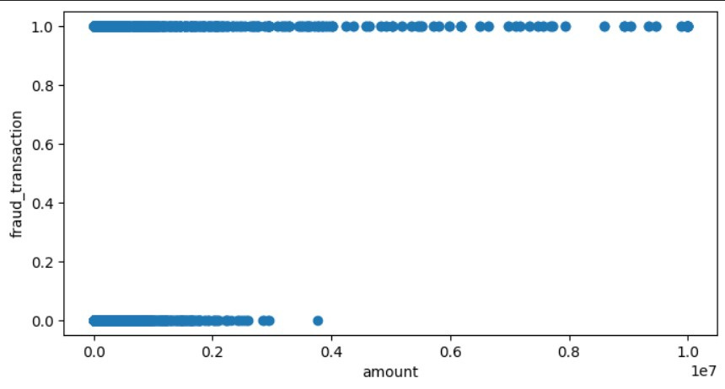
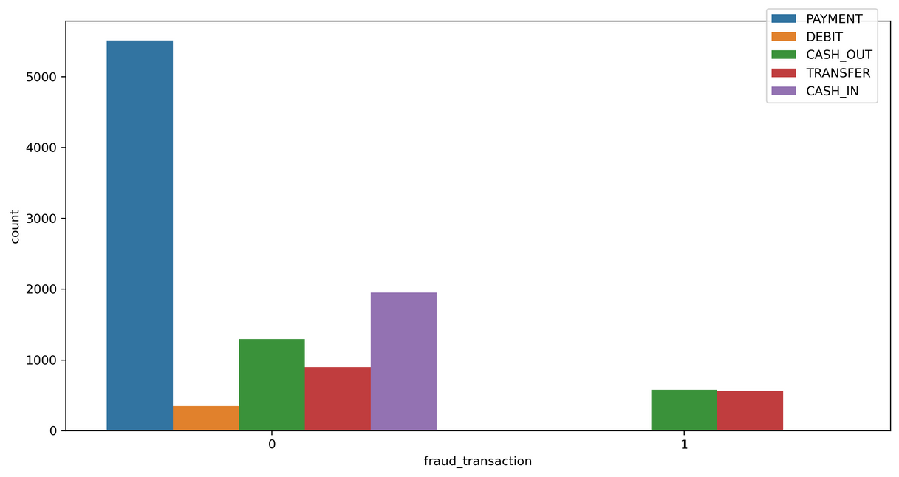
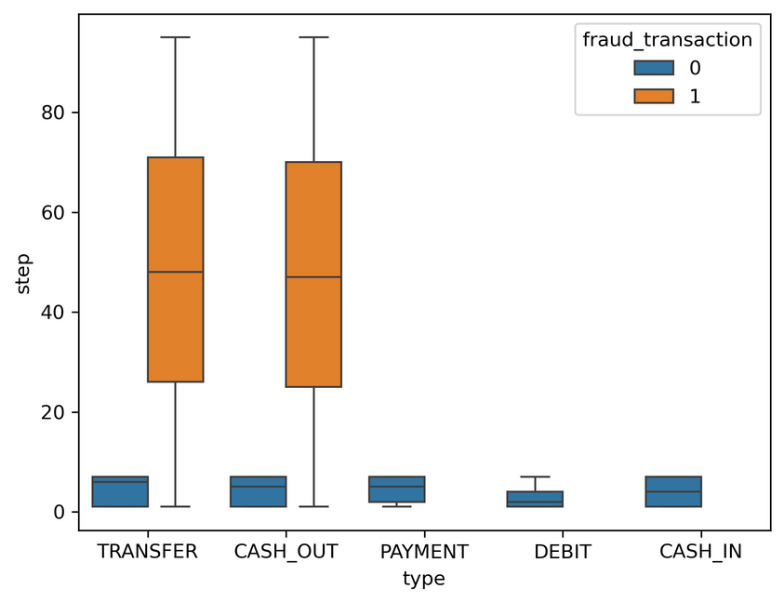
Visualization of Amounts by Fraud Transaction
The visualization aims to identify potential correlations between
the size of transactions and the likelihood of fraud.
By examining the distribution of points, we can assess whether larger
transaction amounts are more associated with fraudulent activity.
3. Multivariate Analysis:
Multivariate analysis involves examining the relationships between three or more variables simultaneously to understand their interactions and effects.
Both the below graphs indicate that transactions of the type 'transfer' and 'cash_out' comprise fraudulent transactions amd rest of type transaction not involve in fraudulent transaction.

Slide 13
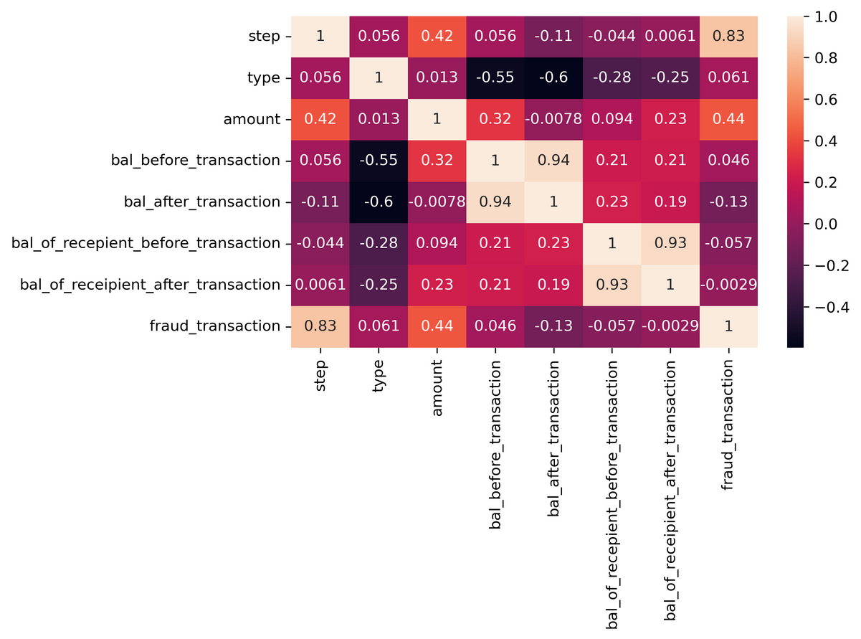
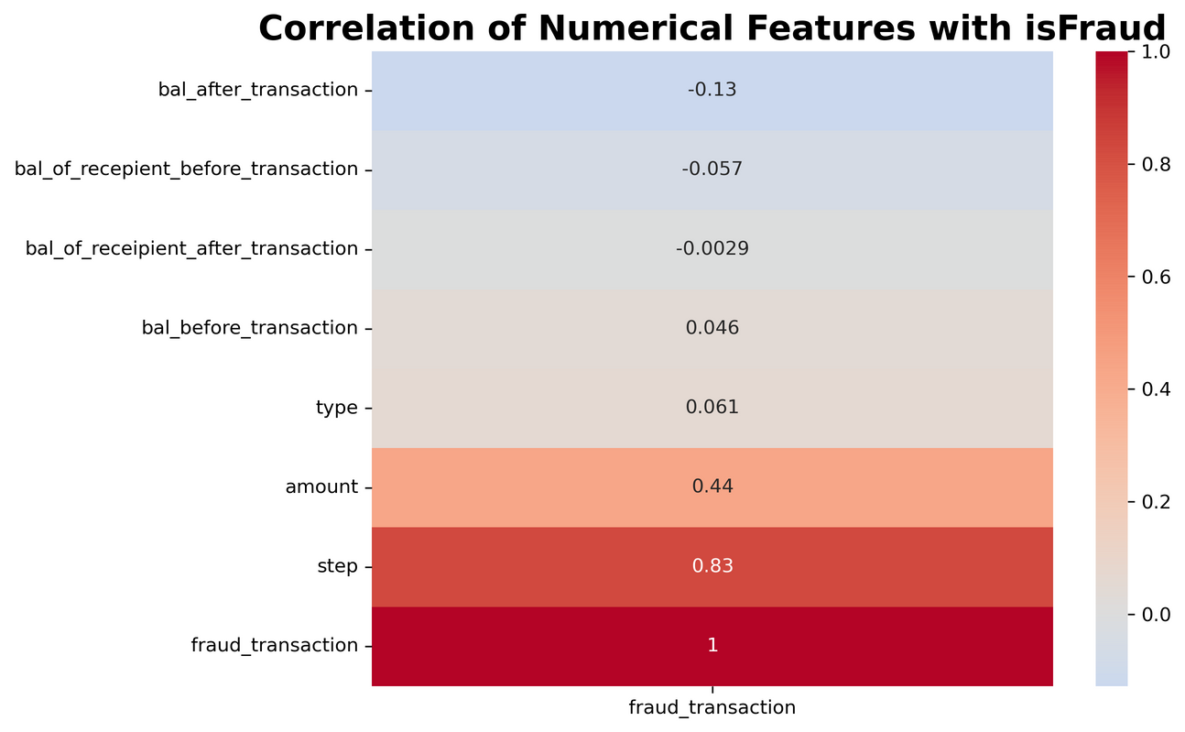
04
Feature Extraction
Deal with the categorical features and Converting the `type` categorical variable into `numerical` by mapping.
Positive correlation were observed between the target variables and “step” and “amount”.
But “bal_of_receipient_after_transaction”, “bal_of_recepient_before_transaction” and “bal_after_transaction" looks like highly negatively correlated with target.
Additionally, “type” and “bal_before_transaction” exhibited moderate correlation with the target.
This heatmap visualizes the correlation of numerical features in the dataset with the fraud_transaction variable, highlighting how different factors relate to fraudulent activity.
Easily identify ‘type’, ‘amount’, ‘step’, and ‘bal_before_transaction’ is highly corelated with fraud_transaction.
So, we can drop rest of feature wich is negative with fraud_transaction or we can carry Forword in training.

Slide 14
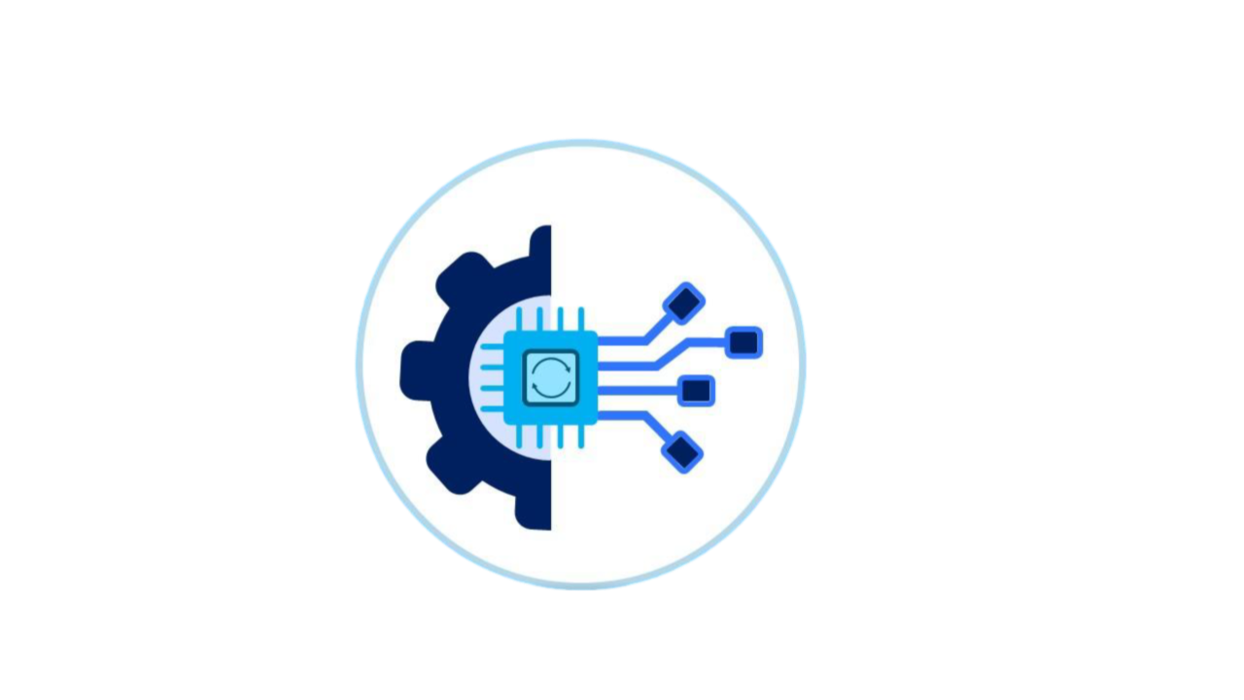
Feature Selection
Irrelevant Feature Removal: All features in the dataset appears to be relevant based on EDA. We will retain all the columns, ensuring no valuable information is lost, especially given the dataset’s small size.
Categorical Feature Encoding: Applied label encoding to the columns on “type” since these variables are nominal variables.
Feature Scalling: Standardizing our features prepares our dataset for more effective modeling, ensuring that our machine learning algorithms can learn from the data without bias introduced by varying scales of measurement.

Slide 15


05
MOdel Traning
Train, Test, Split
•We divided the data into training (70%) and testing (30%) sets.
Spliting data into X and Y
•We divided the dataset into two parts: X and y.
•"X" typically represents the independent Variables, and "y" represents the Dependent (target variable) that we want to predict or understand.

Slide 16
MODEL SELECTION
Model Used:-
•Logistic Regression: logistic Regression is commonly used for binary classification problems. it's preferred because it provides a simple an efficient way to model the relationship between the independent variables and the probability of a certain outcome.
•Random Forest Algorithm: Random Forest: Random Forest is a robust supervised algorithm suitable for both regression and classification tasks.
•Gradient Boosting Classifier: It is a robust and flexible tool for classification tasks, leveraging the power of ensemble learning to achieve high predictive performance. It’s particularly useful in scenarios where model accuracy and interpretability are crucial.
•Support Vector Machine: SVM is a powerful supervised algorithm that works best on smaller datasets but on complex ones. Support Vector Machine(SVM)can be used for both regression and classification tasks, but generally, they work best in classification problems.

Slide 17

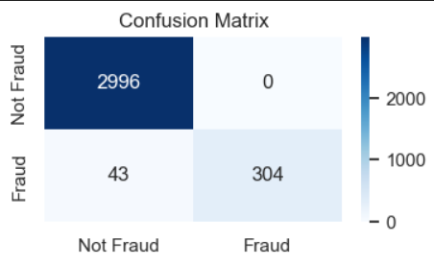
06
Feature Extraction
Understanding
Accuracy
%
Precision
%
Recall
%
F1-Score
%
SCORE
98.71 | 100 | 88 | 93
99.58 | 100 | 96 | 98
99.58 | 100 | 96 | 98
98.74 | 100 | 88 | 94
Precision : It is defined as the ratio of true positive predictions to the total number of positive predictions (true positives and false positives).
High precision indicates that when the model predicts a positive class, it is likely to be correct, which is crucial in scenarios where false positives are costly .
Logistic Regression
Random Forest Classifier
Gradient
Boosting Classifier
Recall: It is defined as the ratio of true positive predictions to the total number of actual positive instances.
High recall indicates that the model is good at capturing most of the actual positive cases, which is particularly important in scenarios where missing a positive instance could have serious consequences.
SVM
F1-Score: It is the harmonic mean of precision and recall.
A higher F1 score indicates better overall performance, especially when both false positives and false negatives are important to consider.
Experimental Result
Confusion Matrix
Logistic Regression: LR achieves 98.71% accuracy and high precision (100%) but lower recall (88%).
Predicted
Predicted
Randome Forest and Gradient Boosting Classifier: Both algorithms maintain 99.58% accuracy, with same precision (100%) and recall (96%)
Actual
Actual
Support Vector Machine: SVM excels with 98.74% accuracy, balanced precision (100%) and recall (88%), showcasing superior overall classification performance.

Slide 18

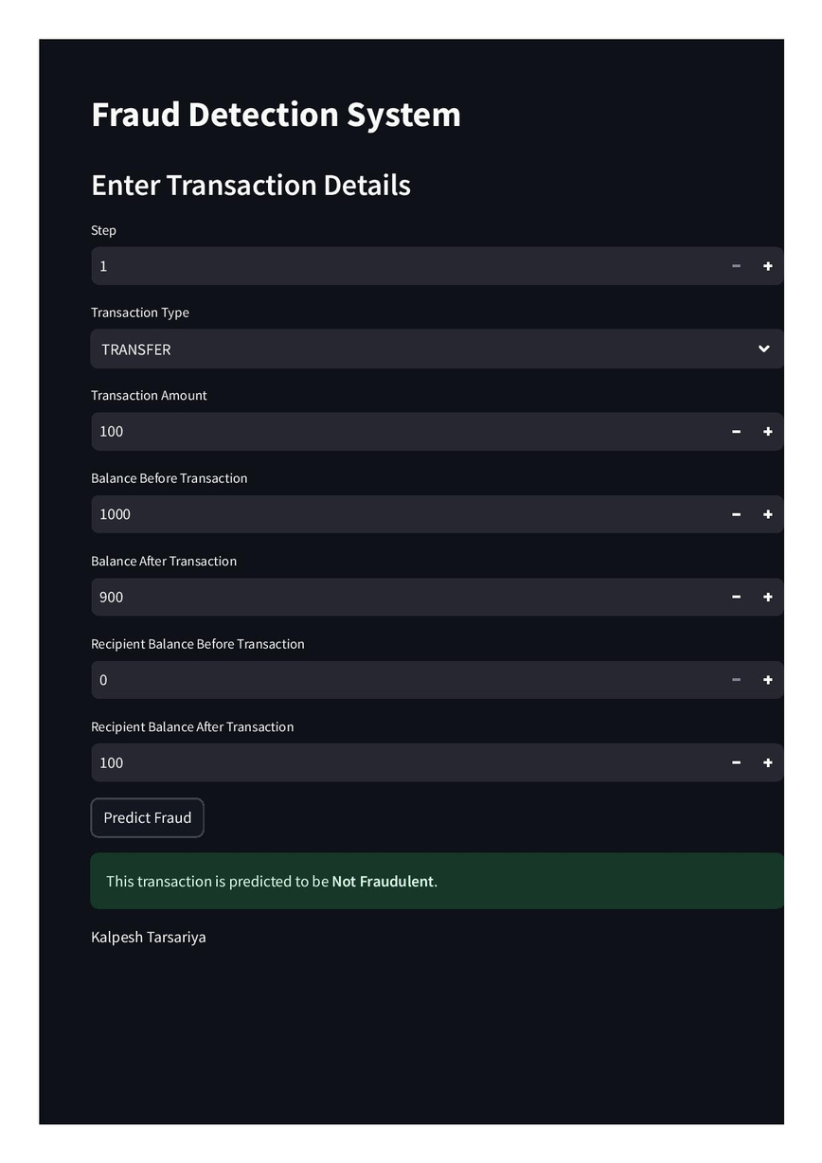
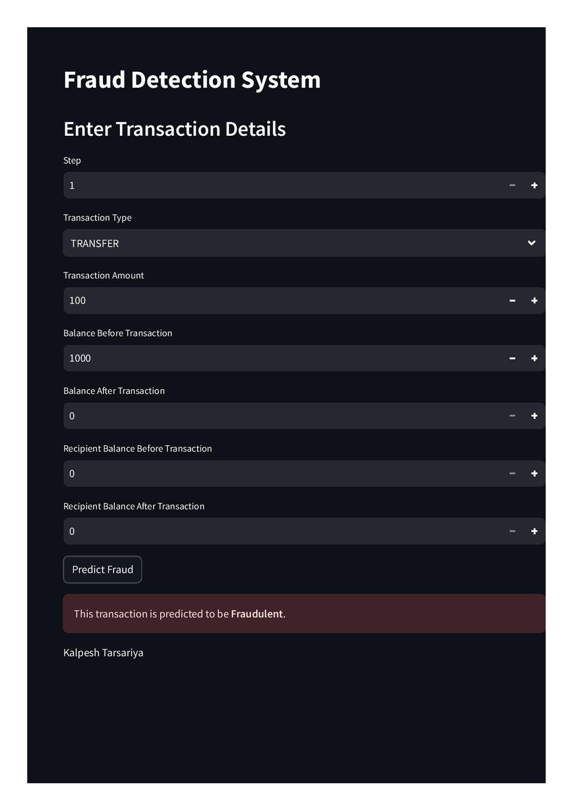
07
Deployment
Streamlit is an open-source framework designed for building
web applications specifically for data science and machine
learning projects.
Streamlit is designed to predict fraudulent transactions
using a Logistic Regression Model. It utilizes user inputs to
assess the likelihood of a transaction being fraudulent or not.
Here i make two transaction which type is transfer amount
from one to other customer.
That is shown one transaction is NOT FRAUDULENT
and second transaction is FRAUDULENT.

Slide 19

Conclusion
Key Findings:
The results indicated that the logistic Regression model had the better accuracy of 98.71% and also better testing accuracy on streamlit app as compare to other model.
Random Forest and Gradient Boosting Classifier has high accuracy and good validation score but these model give wrong accuracy while deploying on streamlit app and also SVM model not give accurate test result.
That means model give low error and high validation error its called LOW BIAS and HIGH VARIANCE model.
So, these model is OVERFITTED.
Business Questions to Address:
Q: What is the model's precision and accuracy in detecting fraudulent transactions?
A: Accuracy: The Logistic Regression model achieved an accuracy of 97.16% on the training data.
Precision: The model has a precision of 100%, meaning that all transactions it classified as fraudulent were indeed
fraudulent.
Q: How reliable is the model in classifying transactions as legitimate or fraudulent?
A: The model shows high reliability in identifying fraudulent transactions due to its high precision. However, the recall was 94%, indicating that while it successfully identifies many fraudulent transactions, it does miss some. This is critical in fraud detection, where false negatives (failing to detect fraud) can be costly.
Q: What are the potential losses due to model errors?
A: To evaluate potential financial losses due to model errors, you established costs for false negatives and false positives:
Cost of False Negatives: ₹1000 per undetected fraudulent transaction.
Cost of False Positives: ₹100 per legitimate transaction falsely flagged as fraudulent.
Revenue from True Positives: ₹500 per correctly identified fraudulent transaction.
Revenue from True Negatives: ₹50 per correctly identified legitimate transaction.
Impact Calculation:
Total Revenue: Sum of revenues from true positives and true negatives.
Total Loss: Sum of losses from false positives and false negatives.
Profit: Total Revenue minus Total Loss.
Total Revenue: 500+50 = 550
Total Loss: 1000+100 = 1100
Profit: 550-1100 = -550

